Slide 1
Topic Comparison for Personalized Research Evaluation
Angela Zhang
Under the direction of Dr. Christopher Healey

Slide 2
Motivation
Evaluating quality of a potential submission is hard for someone less experienced
That difficulty can apply to most researchers: applying to less familiar venues, developing new research focus, or changing research focus
Evolving “relevant” research priorities from top conferences require constant learning of topic landscape (e.g., “LLM-related” research papers grew from 503 in 2019 to 7109 in 2024)Xia, Et al.
Actionable insight are not always provided from conferenced reviewed peer feedback, even after extended waiting periods
Automated topic evaluation for author research landscape would enable better decision making in selecting venues, adjusting research framework, and prioritizing conference deadlines
Xia, Et al. “Analyzing 16,193 LLM Papers for Fun and Profits.”
Notes:
You would evaluate typically based on competing works discovered through a literature review.

Slide 3
Manual Literature Review
Common Challenges
Time Consuming: May have to read through thousands of abstracts
Scan Limited: Manually identify relevant papers from titles, authors or keywords
Existing tools like Google Scholar can hide relevant areas from newer authors while showing more cited works that are not relevant
ConnectedPapers.com try to overcome this but are still limited to citation graphs
Keywords on same research can change overtime, limiting search to specific time periods (i.e. transformers -> pre-trained language models)
No quantitative measure literature review accuracy

Slide 4
Limitations of Literature Diversity
Current tools such as Google Scholar and ConnectedPapers.com can limit diversity by excluding:
Emerging topics (e.g., “Reasoning”, “Chain of Thought”)
Newer or less popular authors with relevant and solid research
Less mainstream topics that have similar solutions
Notes:
Let’s take a look at another way we can approach this problem through topic modelling.

Slide 5
Subjective Publication Readiness
Standard criteria considered for Tier 1 publications:
Novelty
Relevance
Groundbreaking impact
Technically Solid
Addressed ethical considerations
All of these require understanding topical landscape for assessment!
Notes:
Speak this more elegantly. Find some way to give some good examples.
Add another slide - what happens if a paper gets rejected? Authors could spend another 12+ months on rewrites. Feedback can be confusing so they’d need to go back and forth. Topic landscape could change between first submission and multiple rebuttals making a potentially publishable work not publishable.

Slide 6
NeurIPS Reviewer Guidelines
Strong Accept: Technically flawless paper with groundbreaking impact on one or more areas of AI, with exceptionally strong evaluation, reproducibility, and resources, and no unaddressed ethical considerations.
Accept: Technically solid paper, with high impact on at least one sub-area of AI or moderate-to-high impact on more than one area of AI, with good-to-excellent evaluation, resources, reproducibility, and no unaddressed ethical considerations.
Borderline accept: Technically solid paper where reasons to accept outweigh reasons to reject, e.g., limited evaluation. Please use sparingly.
https://neurips.cc/Conferences/2025/ReviewerGuidelines

Slide 7

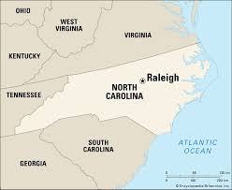
Topic Coverage Impact
Local topic coverage of solutions to same/ similar RQs
Global topic coverage to understand areas of relevance and impact
Notes:
Maybe slightly change wording - Add a small example

Slide 8
Topic Coverage Impact
Resolve some key terms nuance that combine:
Similar research across key term groups from different time periods
Unique key terms with a common identifying topic
Provides context for and filters mass group of literature for specific topic criteria
Semantic retrieval tools for literature review are emerging, but they often do not provide topic modelling.
Notes:
Instead of using individual keywords, topics can provide semantic context across groups. –End: Given the importance of topic modelling for determining publication readiness, we will address implementation challenges through our research goals.

Slide 9
Research Goal
To the best of our knowledge, this work is the first to connect both automated literature scan and peer review
The goal is to offer concise, qualitative data to assist in the subjective decision-making of publication readiness
Topic novelty and completeness
LLM reasoned suggestions of topic relationships to user abstract
Optimize human and AI collaboration in decision making

Slide 10
Topic Novelty and Topic Completeness
“What topics did the author address that are novel?”
Describes core topics in user abstract not commonly present in semantically clustered key terms
“Which topics did the author potentially overlook?”
Describes core topics present in semantically similar
published papers that the user may have overlooked

Slide 11
Human User and AI Text Analytics
Implements a mixed initiative approach that combines the strengths and avoids the limitations of the participants, computer algorithm and human user
AI automated approach provides perspective of general topic applications for relevant domains
Author can apply domain expertise and knowledge of the research area and conference for final decision making
Notes:
Producing results that exceed what either participant would be capable of achieving on their own

Slide 12
Research Overview
Multi-stage, automated pipeline consisting of:
Optimizing document clustering for domain-specific abstracts
Jaccard undersampling implementation on global clusters (developed in Written Preliminary)
Topic modelling
Personalizing topic context with user-provided abstracts through specialized LLM prompting

Slide 13
Background Table of Contents
Automated Literature and Peer Reviews
Domain Text Challenges
Dimension Reduction
Clustering
Jaccard Similarity and Jaccard Undersampling
Topic Modelling
LLM Reasoning Models

Slide 14
Automated Literature Reviews
LLMs have been studied for literature scan automations such as below:
Organizing literature into hierarchies
Scanning bulk literature for inclusion/ exclusion
Specified topics/ key terms/ phrases
Scoping against summary of specified criteria
LLM assisted topic/ key term mining of abstract ideas (e.g., “pain”)
Full or partial authorship of literature surveys

Slide 15
Automated Peer Reviews
LLMs have been studied for peer review automations such as below:
Polite communication and feedback
Structured arguments to improve writing organization
Assessing novelty
Limitation:
“ChatGPT might struggle with in-depth comprehension and contextual understanding of highly specialized or nuanced scientific topics.” Biswas, Et al.
Biswas, S. et al. “ChatGPT and the Future of Journal Reviews: A Feasibility Study”.

Slide 16
Sentence Embedding
LLM Sentence Embeddings are used for all clustering experiments
paraphrase-MiniLM-L6-v2 - a sentence embedding transformer-based model
Outputs a semantic representation of a sentence as an embedding vector of 384 dimensions
Mean-pool: continuous similarity score is averaged across terms
Limitations: Semantic context for individual terms may get diluted for longer sentences
Notes:
For our clustering experiments, we use a sentence embedding model. Go through this slide. Though this is a high performer for most general text cases, there can be additional domain text challenges.

Slide 17
Domain Text Challenges
Domain specific text, especially in scientific publications, may be limiting in the following:
Vocabulary is not part of LLM training data
May be missed for LLMs that rely on text frequency
Can result in LLM excluding domain vocabulary during summarization, concept interpretation, etc.
Data sparsity and outlier challenges

Slide 18
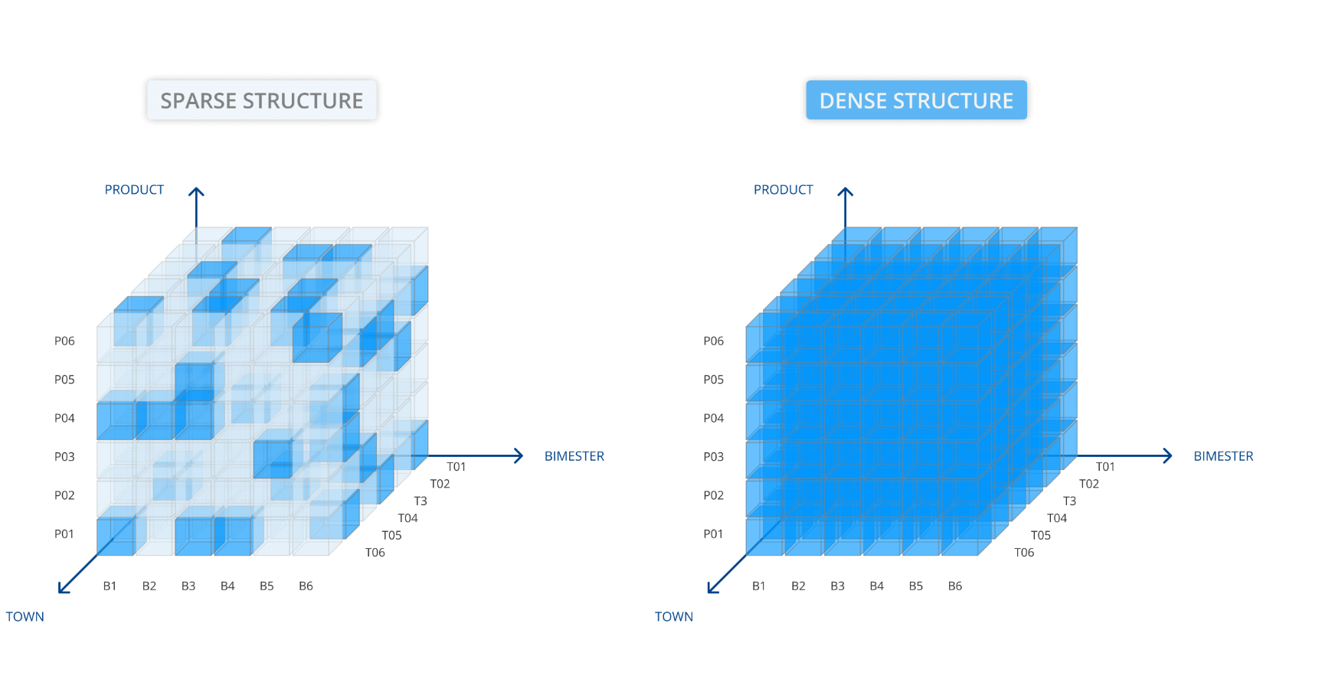
Data Sparsity and Outlier Causes
Clustering with data sparsity results in outliers because there are little common dimensions amongst other documents
Notes:
Text to Vector transformation is often some form of a matrix of word or phrase(n-gram) frequency
Less frequent terms result in a matrix with many zeros
This results in data sparsity (e.g., sparse matrix)
Document outliers are unique data points that typically can not be semantically grouped

Slide 19
Data Sparsity and Outlier Challenges
The following can result in data sparsity:
Specialized terms are less likely to appear across multiple abstracts
Novelty criteria may encourage unique descriptions
Abstracts typically contain less, general supporting statements
Context overfitting in embedding models (e.g., bias of training data for specific domains)
This limits clustering and results in high outliers!

Slide 20
Dimension Reduction
Embedding vectors can contain 300+ dimensions
Lower dimension to enable clustering
Linear transformations - compact dimensions through linear separations
Non Linear transformation - typically through manifold learning (e.g., curves, folds, etc.)

Slide 21
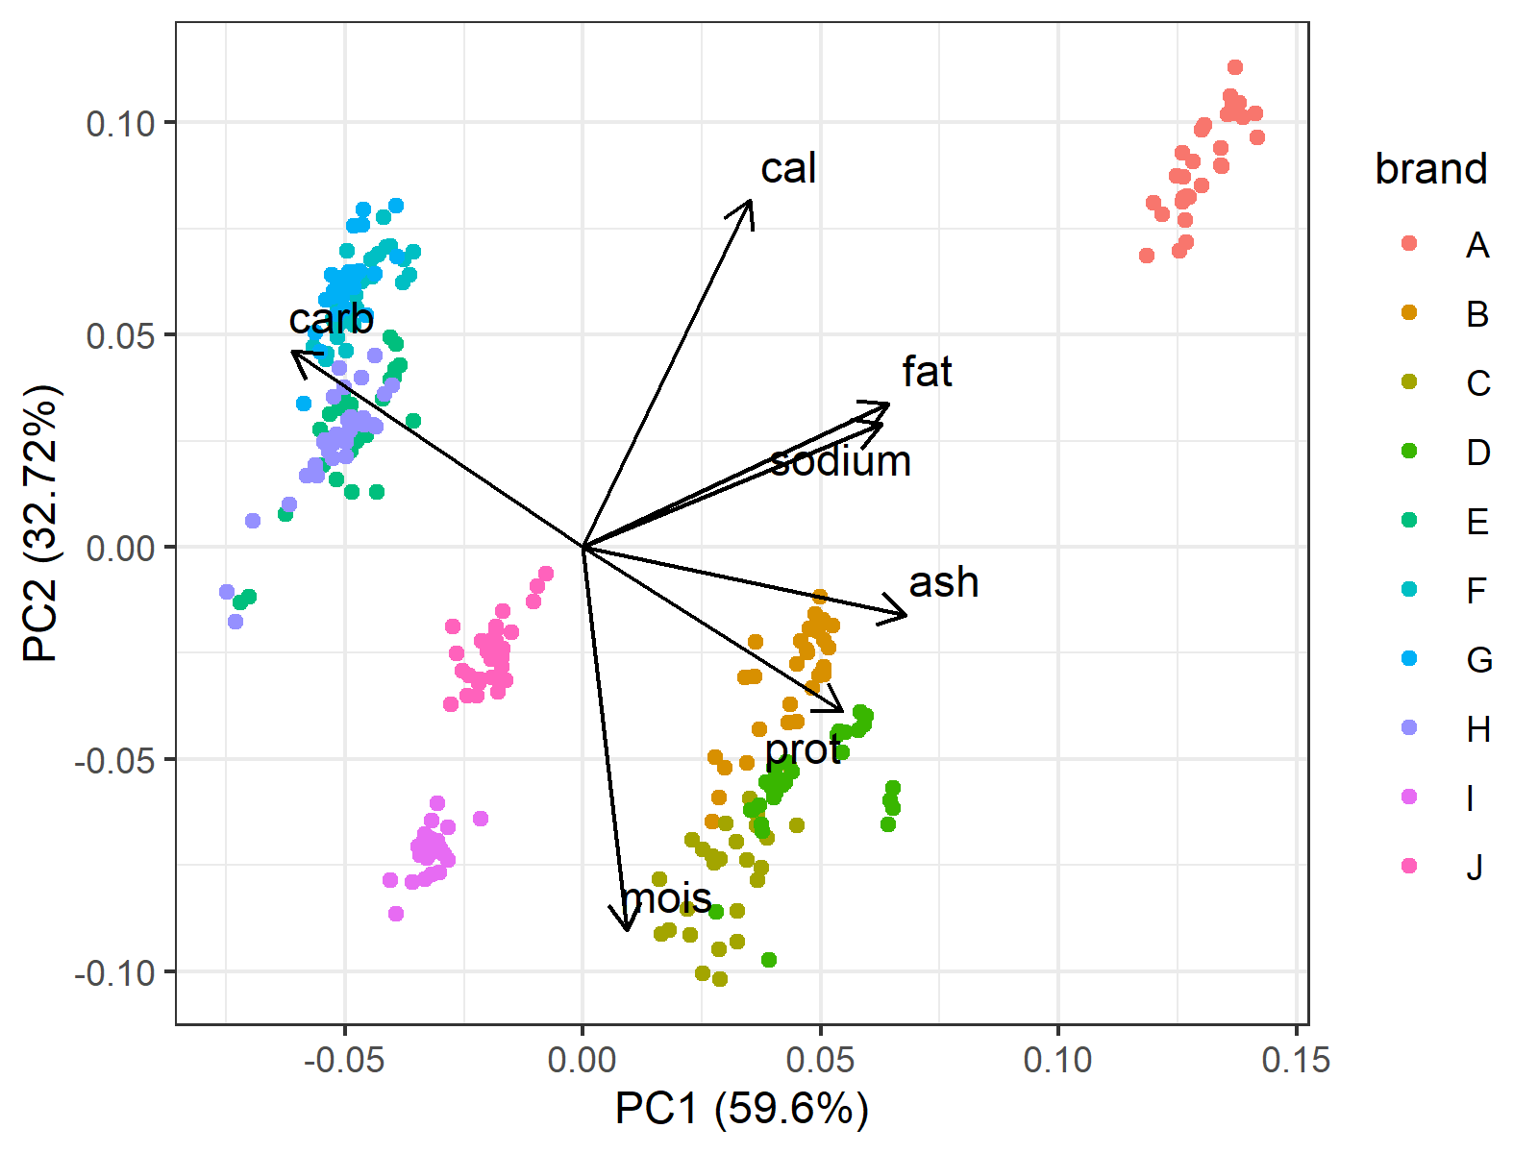
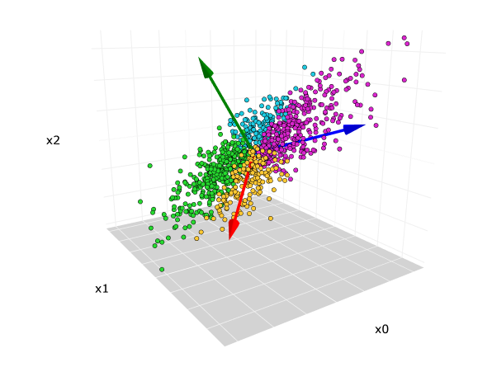
Principal Component Analysis (PCA)
Reduced orthogonal axes that retain required amount of variance in original data space
Goal is to minimize dimensions while maintaining data pattern of original data space

Slide 22
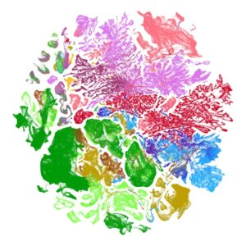

Uniform Manifold Approximation and Projection (UMAP)
Based on manifold learning, UMAP converts distances into probability similarities of neighborhood likeliness, that is, how likely another point is to be a neighbor.
Notes:
UMAP is based upon manifold learning, which means instead of a flat plane, it observes points on
a lower dimension, curved manifold structure (e.g., a geometric representation of neighborhood
pairwise distances) [McI18]. It then creates a low-dimensional plane using these local manifold
approximations. The final topic graph is optimized by minimizing the cross entropy loss between
the original structure and lower-dimension plane.

Slide 23
Clustering
K-MEANS - Centroid based, will not separate outliers
DBSCAN - Sensitive to outliers, based on uniform euclidean distance, less able to conform to data variance
HDBSCAN - Extends DBSCAN by using relationship probabilities to capture data variance (e.g., varying popularity across different subtopics)

Slide 24
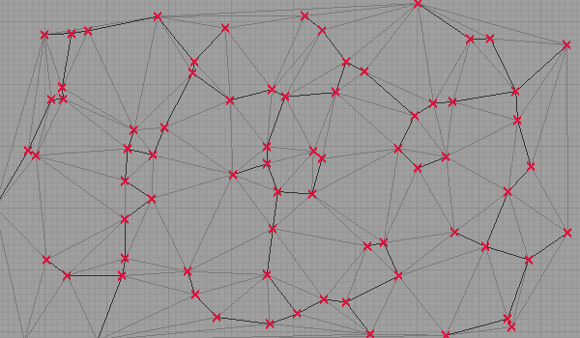
Hierarchical DBSCAN Clustering
Hierarchical Density-Based Spatial Clustering of Applications with Noise
Extends DBSCAN by clustering with varying densities
Builds minimum spanning tree with mutual reachability distance
Prune large distance edges (i.e., remove excess mass)
Extract clusters based on minPts
May form global clusters
Notes:
A significant portion of the data can result in global clusters if there are not strong local relationships. Even though these global clusters can contain multiple subtopics, we would still like to be able to use them. Thus, we will Jaccard Similarity in an effort to better optimize these clusters.

Slide 25
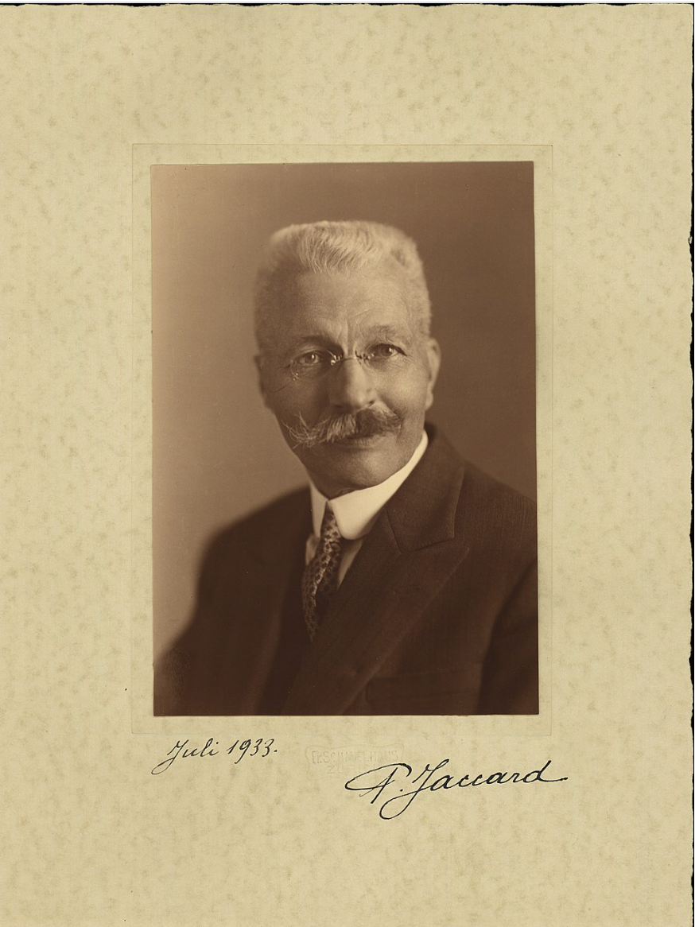
Jaccard Similarity
Developed by Paul Jaccard in 1901
Measures the similarity of items between two sets
J(A,B) =|A ∩ B| / |A ∪ B|
Set intersection of A and B / Set Union of A and B
Range - always be between 0 and 1
higher Jaccard values indicating higher similarities
Binary consideration of whether the term is or is not in the document
Commonly used to find duplicate documents or key-word overlap
From 890 Written Preliminary
Notes:
Slide from 890 presentation
Measures overlap between two sets
Ratio of similar words to total unique words.

Slide 26
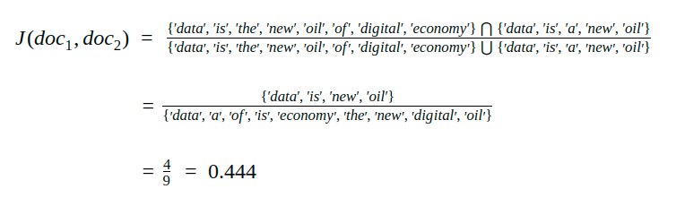
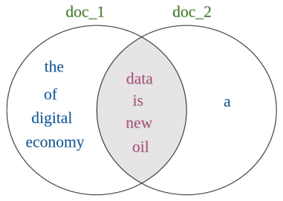
Jaccard Similarity Text Example
Measures overlap between two sets, equivalent to overlapping words/ total unique words
Credit: https://studymachinelearning.com/jaccard-similarity-text-similarity-metric-in-nlp/
From 890 Written Preliminary

Slide 27
Jaccard Undersampling Procedure
Goal: Optimize for single topic clusters
Developed for balancing datasets of unsupervised clustering
Identify document pairs with higher Jaccard Similarity (preset threshold)
Removal of one of those documents should:
Provide better clustering separation if differing topics
Keep cluster shape if same topic
From 890 Written Preliminary

Slide 28
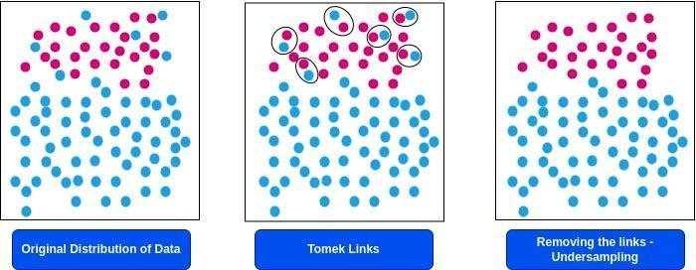
Supervised Undersampling - TOMEK link
Jaccard undersampling is similar, in that it observes data points that have high Jaccard Similarity values but without knowledge of labels.
From 890 Written Preliminary
Notes:
https://www.researchgate.net/figure/Illustration-of-Tomek-Links_fig4_363269818

Slide 29
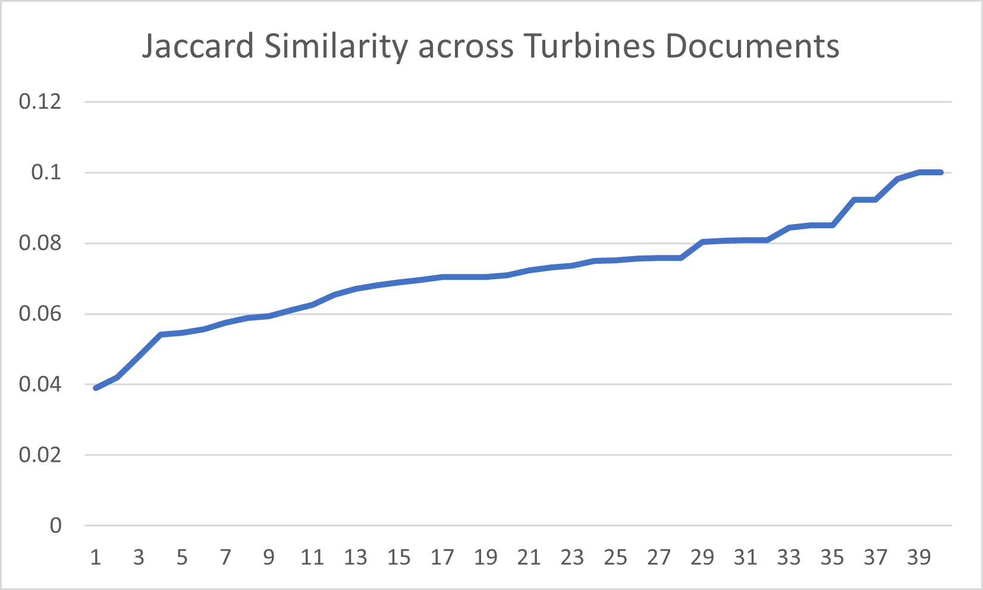
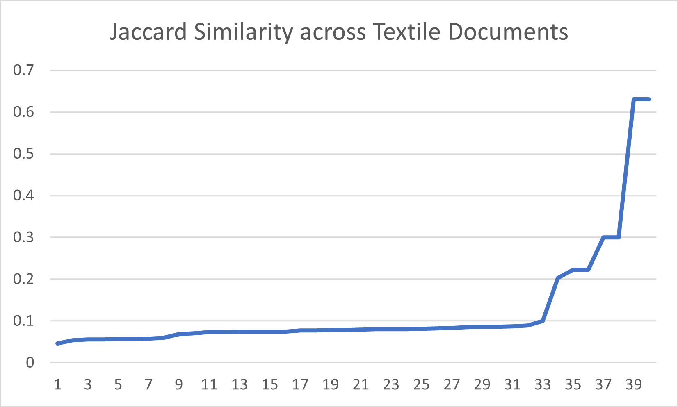
Distinguishing Max Jaccard Trendlines
Jaccard Similarity
Document ID
Document ID
Topics that are specific to certain domains have linear Jaccard Similarity relationships
Topics that can span across multiple domains have more exponential Jaccard Similarity relationships
From 890 Written Preliminary
Notes:
If we observe these two groups as “global clusters”, then based on Jaccard pair-wise distance max similarities, Turbines would not benefit from Jaccard undersampling. However, using it to compact the Textiles global cluster may result in more precise, single topic clusters. Left side shows that there may be fairly tight relationships between document contexts. The right trendline indicates that there might be documents with more variance in neighborhood structures - some much closer than others, while still part of the same global cluster. This could potentially be due to several well separated subtopics.

Slide 30
Topic Modelling
Extracting common themes or topics
Probabilistic Topic Modelling:
Latent Dirichlet Allocation (LDA)
Latent Semantic Analysis (LSA)
c-TF-IDF + LLM embeddings: BERTopic
Zero-shot LLM prompting

Slide 31
Latent Dirichlet Allocation
Applied as an unsupervised topic modelling approach
Generative probabilistic model that discovers latent topics within a collection of documents
Each document is represented as a mixture of topics
Probabilistic topic models typically perform well with more well-structured data sets (e.g. repetitive news articles)
Potential Limitation: May not be suitable for shorter documents as variance inference is limited

Slide 32
Sentence Extraction with OCCAMS
Optimal Combinatorial Covering Algorithm for Multi-document Summarization (OCCAMS) uses LSA with greedy heuristics for budgeted maximal coverage (BMC) and a dynamic programming-based polynomial time approximation scheme (FP-TAS) to select most critical sentences/ ngrams
The optimization goal is to maximize the combined weights of the terms covered and minimize redundancy

Slide 33
BERTopic Topic Modelling for Clusters
BERTopic is a topic modeling algorithm that uses LLM word embeddings (BERT) and TF-IDF to form clusters
UMAP is applied for dimension reduction and HDBSCAN is used for clustering
Original text is transformed into a c-TF-IDF matrix representing an entire cluster as one document
The highest-scoring keywords are then used to define “topics”

Slide 34
LLM Reasoning Models
Reasoning models automate Chain of Thought (COT) with intermediate decisions, using structured tree based approaches and the following:
Reinforcement Learning Human Feedback (RLHF)
Reinforcement Learning Artificial Intelligence Feedback (RLAIF)
Backtracking (specific to Grok-3)

Slide 35
Grok-3
Specifically developed for scientific research
Modes we will cover: Think and DeepSearch
Achieved some of the highest reasoning benchmarks:
93.3% on the AIME 2025 mathematical reasoning test, surpassing GPT-4o (79%)
84.6% onGPQA (graduate-level scientific problem-solving);
84.6% on LiveCodeBench;
79.4% on Chatbot Arena
Grok-3 was also the first model to surpass a 1400 ELO score, a rating system widely used in competitive games like chess.
https://x.ai/news/grok-3

Slide 36
Grok-3 Limitations
No published research, making evaluation and designing prompts more challenging
Proprietary, not publicly documented training data
Part of search uses X (previously Twitter) data so may not always be true
Several different features and modes but documentation is not widely available, limiting usage potential
Despite these limitations,Grok-3’s reasoning ability can be advantageous in deriving scientific topic relationships

Slide 37
Research Proposal
High Level Overview
Clustering
Jaccard Undersampling for Global Clusters
Topic Modelling Clusters
Topic Modelling Single User Abstracts
Personalization - Specialized Prompting

Slide 38
High Level Overview
Automated Literature Scan
Procedures to effectively cluster published research articles
Provide valuable key terms representing a single topic
Topic Review Personalization
Analyzes user abstract with clustered documents
Personalize LLM reasoned topic relations

Slide 39

Automated Literature Scan
Step 1: Clustering + Dimension Reduction
Step 2: Jaccard Undersampling
Step 3: Topic Modelling

Slide 40
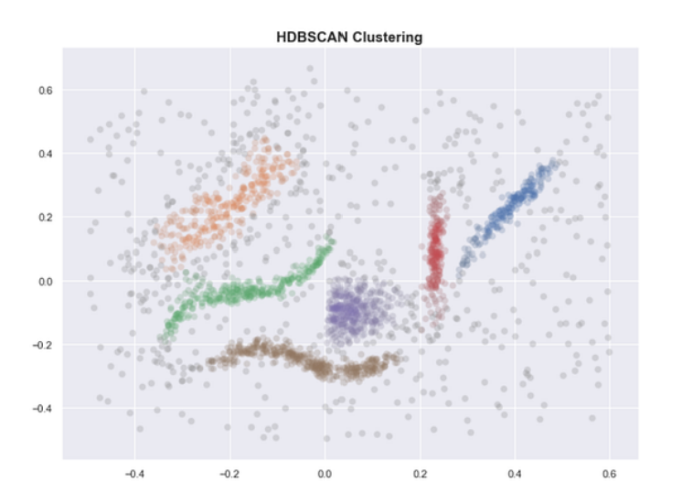
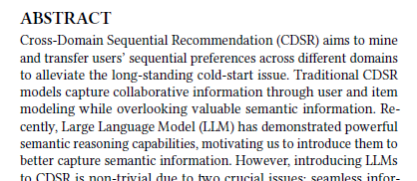


Topic Review Personalization
Step 4
Step 5
Cluster key terms: “collaborative”, “LLM”, “long-tail”, “marketing”, “customer”

Slide 41
Scalable, Multi-Stage Automated Approach
Step 1
Step 2
Step 3
Step 4
Step 5
Steps 1 - Steps 3: High Level Literature Scan
Automate literature review process by forming single topic clusters
Steps 4 - Steps 5: Personalization
Given a user abstract, perform topic comparisons across keywords of most semantically related clusters

Slide 42
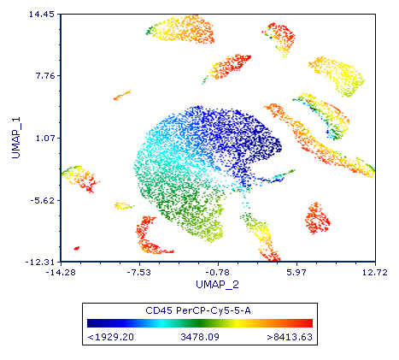
Clustering Published Research
Text to Vector: Sentence Embedding Model
Selecting Clustering Algorithm
Clustering with Dimension Reduction
PCA and UMAP
Global Clusters and Jaccard Undersampling

Slide 43
Selecting Clustering Algorithm
In evaluating K-Means, DBSCAN, and HDBSCAN, appropriate algorithm is selected based on the following:
Outlier sensitive
Optimize eliminating noisy dimensions with selected dimension reduction application
Account for data variance
Optimize for single topic clusters

Slide 44
Clustering with Dimension Reduction
Goal
Reduce data to the lowest dimension that prioritizes one key topic for each cluster
Retain the most critical information that effectively distinguishes cluster boundaries
Improve outlier precision

Slide 45
Implementation: Principal Component Analysis (PCA)
PCA leverages eigenvector variance distinctions to separate the most meaningful patterns from noise and uninteresting correlations
Few distinguishable dimensions could better contribute to single topic clusters
Challenge: Are there enough similarities amongst scientific topics for PCA to be effective?

Slide 46
Implementation: Uniform Manifold Approximation and Projection (UMAP)
Manifold learning techniques that use curved structures with concave and convex boundaries
Reduces outliers by clustering data with non-linear structures (e.g., varying densities between differing authorship volume, popularity within growing subtopics)
Challenge: For global clustered documents, are they easily distinguishable from local clusters? Can we still utilize them for topic matching?

Slide 47
Jaccard Undersampling for Global Clusters
Global clusters may represent topics that span multiple domains or have similar subgroups
Perform the same experiment to confirm that global topics have noticeable peaks in their maximum Jaccard similarity trends
If true, Jaccard undersampling can effectively separate smaller clusters within global clusters
Improve our ability to generate clusters with a single
dominant topic

Slide 48
Topic Modelling Single User Abstracts
Topic modelling for a single abstract has additional challenges
Limited text frequency
Difficult to prioritize which terms are topic dependent
Lack of supporting background
Isolated from related supporting documents

Slide 49
Topic Modelling Single User Abstracts
Identify significant ideas within a single user abstract
(1) Creating semantic embeddings
Can mean-pooling capture effective semantic meaning for abstract topic?
(2) Extracting critical sentences
Do abstracts have enough context to warrant sentence prioritization?
(3) Performing abstractive topic modeling
Can LLM prompted topic modelling perform consistently across similar abstract topics?

Slide 50
Topic Matching
Topic modelling results are used to identify document cluster with the highest semantic similarity to the user’s abstract.
Will sentence embeddings accurate compare similarities with clustered key term embeddings?
Is there a threshold in sentence length in which embeddings lose topical meaning?
How does LLM topic generation consistency impact performance of matching with clustered key terms?
Notes:
Additional observations and challenges to interpreting topic modelling results

Slide 51
Personalization - Specialized Prompting
Critical components that need to be addressed when developing prompt to identify topic relations:
Interpret definition of clustered key-words given the set of neighboring key-words
e.g., “natural” in terms of “computers” refers to “language” instead of “organic”
Interpret potential relationships of clustered key-words to user abstract
e.g., “Calculus” for a robotics abstract may reference inclusion of theoretical proof
Interpret topic relationships instead of exact key-word matching
e.g., identify when an abstract may contain mathematical proof without the word “calculus”
Notes:
Determining whether the model actually interpreted topical meaning correctly requires several challenging considerations.

Slide 52
Completed Work
Dataset
Clustering Experiments Performed
Dimension Reduction Observations (PCA and UMAP)
Text Preprocessing
Defining Cluster Sizes
Defining Outlier Baseline
Cluster Topic Modelling
Single Abstract Topic Modelling

Slide 53

Dataset
We extract our data (6514 abstracts) from the dataset Kowsari et al. provided, specifically the Computer Science category with provided seventeen subcategories. We did not use subcategories to guide or evaluate clustering.
Kowsari, K. et al. “HDLTex: Hierarchical Deep Learning for Text Classification”. 2017 16th IEEE International Conference onMachine Learning and Applications (ICMLA). 2017, pp. 364–371.
Notes:
Kowsari, K. et al. “HDLTex: Hierarchical Deep Learning for Text Classification”. 2017 16th IEEE International Conference onMachine Learning and Applications (ICMLA). 2017, pp. 364–371.

Slide 54

Dataset Limitations
Existing approaches categorize scientific research with a few broad categories (including dataset used)
Unable to find available benchmark on scientific text dataset that have unsupervised clustering beyond a couple (still broad) subtopic levels
Notes:
Often, subtopics contain critical information regarding research novelty and relevance. This type of work is valuable but incredibly difficult to publish because of no existing dataset benchmarks (beyond very limiting subtopics) in published research. Clustering also enables to take more control of driving topical decisions (i.e., emphasize or limit certain data variations for specific research goals without restricting to select key terms.) Thus, it’s a valuable field to study but with heavy limitations to publication.

Slide 55
Clustering Experiments Performed
Text to Vector Representation | Clustering | Dimension Reduction | Outliers
TF-IDF | HDBSCAN | NONE | >90%
TF-IDF | HDBSCAN | PCA | >90%
LLM Sentence Embedding | HDBSCAN | NONE | >90%
LLM Sentence Embedding | HDBSCAN | PCA | ~85%
LLM Sentence Embedding | HDBSCAN | UMAP | ~35%
Notes:
*Look up real numbers for outliers

Slide 56
PCA and UMAP Observations
PCA was not successful - no significant distinctions among any of their corresponding eigenvalues
Data sparsity challenge
Lower and more uniform vocabulary distribution due to a broader distribution of topics and vocabulary
~85% outliers
UMAP was much better for outliers (~35%)
Global clusters still accounts for ~20% of total dataset (1394/6514 abstracts)
Notes:
Question: Results vary on experiment runs. Latest experiment was 30% outliers for UMAP.

Slide 57
Text Preprocessing
Text preprocessing was done for TF-IDF related experiments
For sentence embeddings, we did not expect traditional preprocessing techniques to have a significant impact so our preliminary experiments did not include preprocessing
We later discovered that BERTopic uses both a version of TF-IDF and LLM embeddings so will preprocess sentence embedding future experiments

Slide 58
Defining Cluster Sizes
Goal: One topic per cluster, maximize topic coherency
Set minimum of 5 documents per cluster
No upper bound as it’s topic dependent
Established factors contributing to non-uniform cluster distributions: Frequency and Diversity
Popular topic (e.g., “large language models”) can be narrow in scope -> higher frequency and lower diversity, more cluster density
More unique topics (e.g., “smart fabric”) -> lower frequency and diversity, smaller cluster and less density

Slide 59
LDA Topic Modelling for Clusters
Experimented to see how the general nature of the model would apply to text abstracts
Ten and twenty topics to observe differences
Both shared similar outcomes:
One topic was found to be dominant
Remaining averaged an influence of less than 1%
Abstract’s short text structure can be an inappropriate fit for probabilistic models that rely on prior distributions

Slide 60
BERTopic Topic Modelling for Clusters
More effective in extracting appropriate key terms.
Criteria for effectiveness can be determined by:
Semantic relevance of key terms
Diversity of clusters
Representative topics (e.g., key terms can relate to majority of cluster)

Slide 61
OCCAMS implementation and results
Preprocessing: In addition to standard text preprocessing, abstracts are split by sentence
Potential Setbacks: If abstracts are limited in supporting terms or sentences, each sentence could be weighted equally. This will limit the model’s extraction abilities
Observations: Not directly feasible for many abstracts
Some abstracts have only a few long sentences
Surprisingly, some abstracts only have one sentence

Slide 62
Remaining Work
Implement Jaccard undersampling for global clusters
Complete topic modelling for single user abstracts
Implement LLM embeddings and zero-shot LLM
Experiment with preset ngrams for OCCAMS instead of sentences
Topic matching most semantically similar clusters to user abstract
Specialized Topic enhanced RAG prompting for Reasoning LLM

Slide 63
Timeline
Written Preliminary Exam: Jaccard Similarity Undersampling for Document Clustering | October 4, 2023
Oral Preliminary Exam: Topic Focused Peer Review Automation using Unsupervised Learning and Large Language Models | July 10, 2025
Remaining Work Estimated Completion | October 2025
Thesis Completion | Before January 2026

Slide 64
Thank you for attending my talk.
Are there any questions?

Slide 65
Appendix

Slide 66
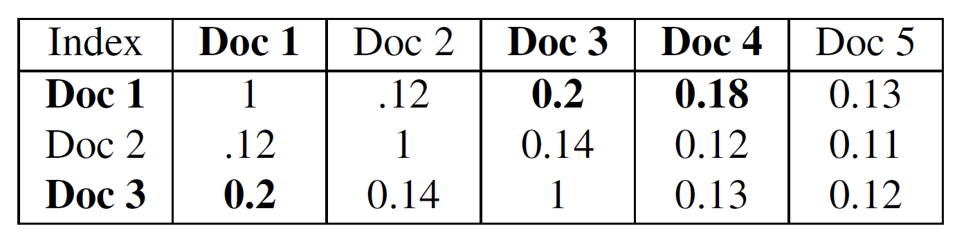
Selecting documents for review and removal
Demonstration of Jaccard undersampling between respective documents. Our experiment used Jaccard >=.15
Hash dictionary
Document removal is based on processing order (1>3>4)
First document in match is hash key, Second document is hash value
If hash key already exist, then don’t do anything (indicating document is a match with multiple documents)
Remove all documents that are hash keys
e.g., Dictionary Key -> Doc 1, Value -> Doc 3
From 890 Written Preliminary
Notes:
From 890 slide

Slide 67
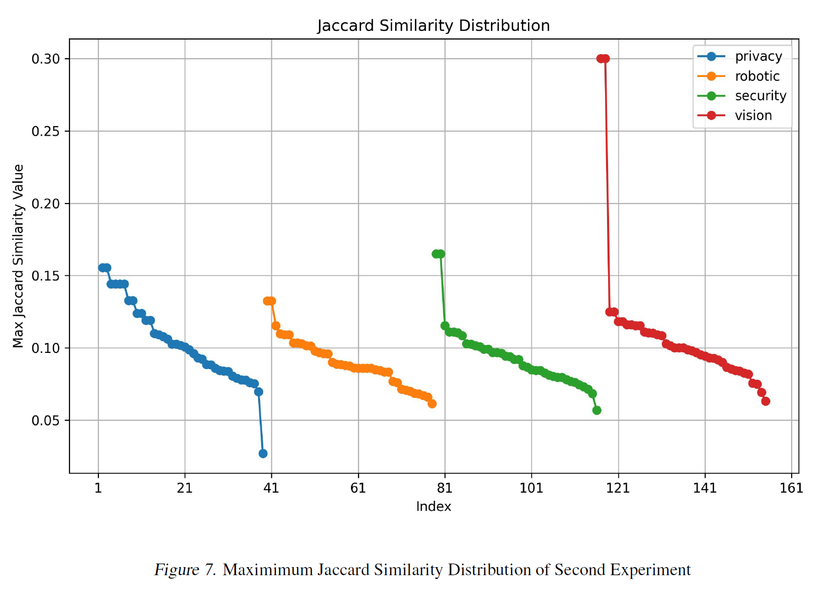
Results of Second Experiment
From 890 Written Preliminary

Slide 68
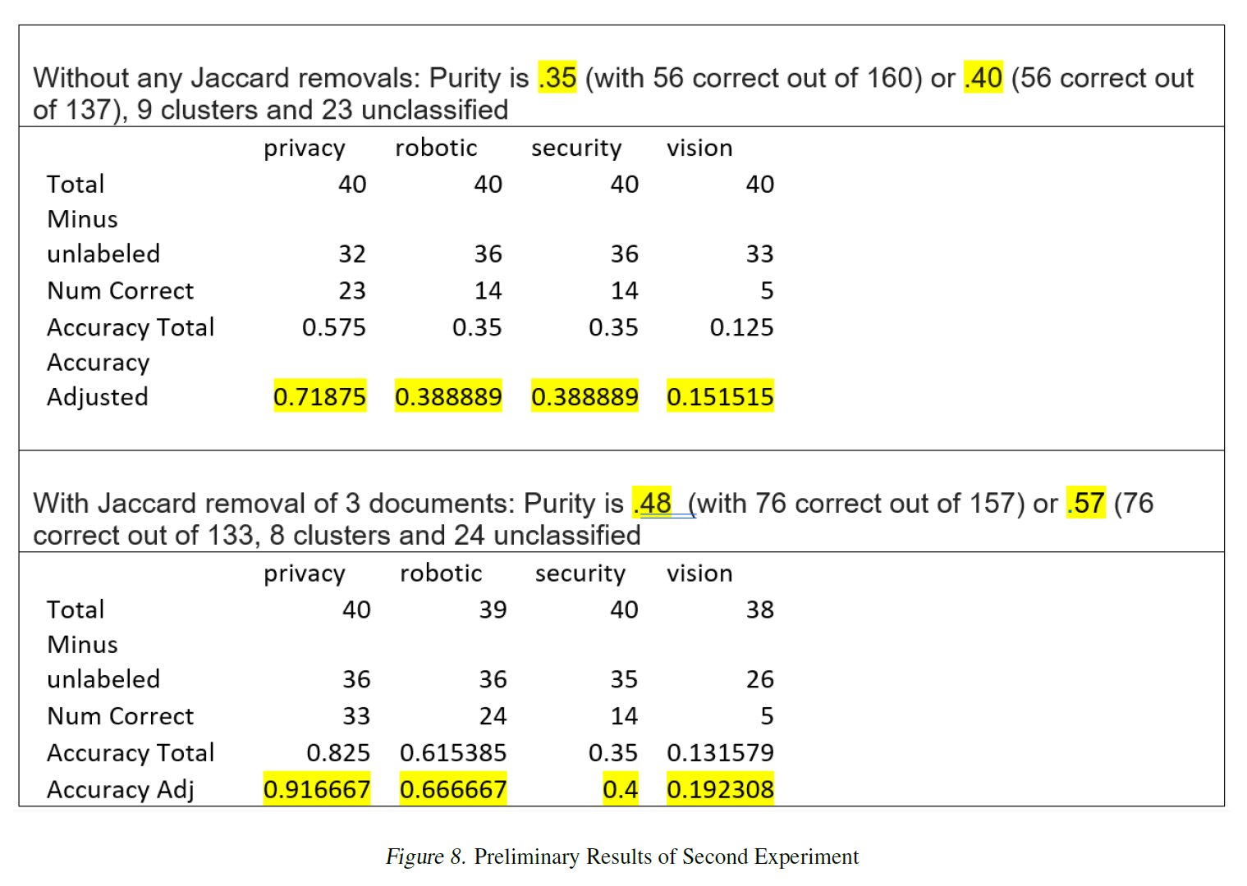
Results of Second Experiment
From 890 Written Preliminary

Slide 69
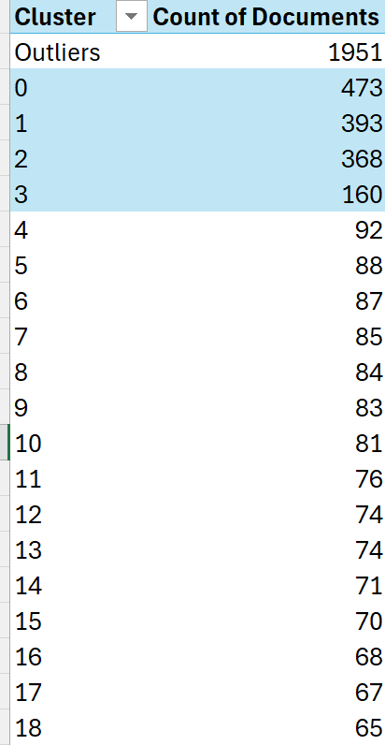
Classifying Global Clusters
…….

Slide 70
Topic Modelling Single User Abstracts
Approach | Pros | Challenges
Apply LLM sentence embeddings to full abstract | Will contain all semantic information | Mean-pooling may dilute meaning from any individual term Potentially mislead the topic
First apply sentence extraction technique | Shortens the abstract Less negative impact of mean-pooling | Reliant on supportive text, which is not prevalent in abstracts Not meaningful when abstract have only few sentences.
Zero-shot LLM prompting | Provides specific keywords Abstracts supporting knowledge from large pool of training data | Less interpretability Might be difficult to tune temperature or variability of key-word changes between similar abstracts Domain specific terms could be missed

Slide 71
Defining Outlier Baseline
Previous work by [Weng et al.] clustered 593 abstracts collected from SCOPUS using GPT-3 embeddings, UMAP, and HDBSCAN
Classified 48.3% (287 out of 593 abstracts) as outliers
key terms: “AI”, “machine learning,” and “urban-related planning, design, governance and data”
Broader computer science domain should generate at least as many outliers
48.3% is set as an outlier baseline threshold

